Slide 1
Capstone Engagement
Assessment, Analysis, and Hardening of a Vulnerable System
Josh Black
University of Richmond
Cyber Security Bootcamp
November 11, 2021

Slide 2
Table of Contents
This document contains the following sections:
01
Network Topology
02
Red Team: Security Assessment
03
Blue Team: Log Analysis and Attack Characterization
Hardening: Proposed Alarms and Mitigation Strategies
04

Slide 3
Network Topology
‹#›

Slide 4
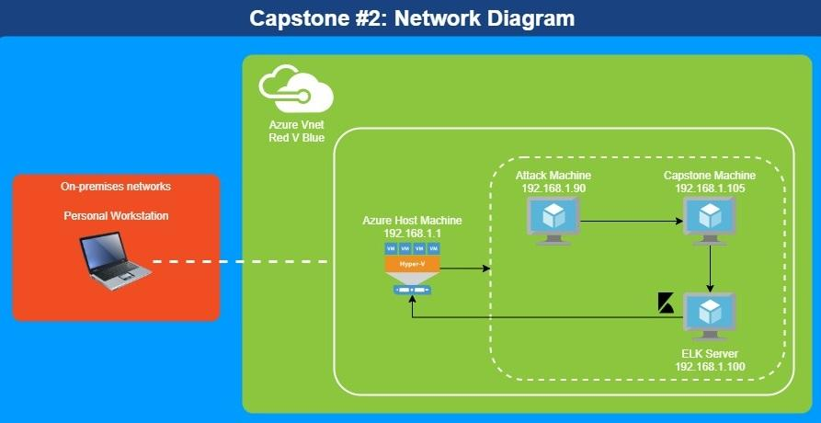
Network Topology
Network
IP Range: 192.168.1.0/24
Gateway: 192.168.1.1
Machines
IPv4: 192.168.1.90
OS: Linux
Hostname: Kali
IPv4: 192.168.1.100
OS: Linux
Hostname: ELK
IPv4: 192.168.1.105
OS: Linux
Hostname: Capstone
IPv4: 192.168.1.1
OS: Windows
Hostname: Azure Host Machine

Slide 5

Red Team
Security Assessment
‹#›

Slide 6
Recon: Describing the Target
Nmap identified the following hosts on the network:
Hostname | IP Address | Role on Network
Hyper-V Azure Machine ML-RefVm-684427 | 192.168.1.1 | Host Machine Cloud-Based
Kali | 192.168.1.90 | Attacking Machine
ELK Stack | 192.168.1.100 | Network Monitoring Machine Running Kibana
Capstone | 192.168.1.105 | Target Machine Replicating a vulnerable server

Slide 7
Vulnerability Assessment
The assessment uncovered the following critical vulnerabilities in the target:
Vulnerability | Description | Impact
Sensitive Data Exposure OWASP Top 10 #3 || Critical | The secret_folder is publicly accessible, but contains sensitive data intended only for authorized personnel. | The exposure compromises credentials that attackers can use to break into the web server.
Unauthorized File Upload Critical | Users are allowed to upload arbitrary files to the web server. | This vulnerability allows attackers to upload PHP scripts to the server.
Remote Code Execution via Command Injection OWASP Top 10 #1 || Critical | Attackers can use PHP scripts to execute arbitrary shell commands. | Vulnerability allows attackers to open a reverse shell to the server.

Slide 8
Vulnerability Assessment
The assessment uncovered the following vulnerabilities in the target:
Vulnerability | Description | Impact
Directory Indexing Vulnerability CWE-548 | Attacker can view and download content of a directory located on a vulnerable device. CWE-548 refers to an informational leak through directory listing. | The attacker can gain access to source code, or devise other exploits. The directory listing can compromise private or confidential data.
Hashed Passwords | If a password is not salted it can be cracked via online tools such as www.crackstation.net/ or programs such as hashcat. | Once the password is cracked, and if a username is already known, a hacker can access system files.
Ability to discover password by Brute Force CVE-2019-3746 | When an attacker uses numerous username and password combinations to access a device and/or system. | Easy system access by use of brute force with common password lists such as rockyou.txt by programs such as Hydra

Slide 9
Vulnerability Assessment
The assessment uncovered the following vulnerabilities in the target:
Vulnerability | Description | Impact
Weak Passwords | Commonly used passwords such as simple words, and the lack of password complexity, such as the inclusion of symbols, numbers and capitals. | System access could be discovered by social engineering. https://thycotic.com/resources/password-strength-checker/ suggests that ‘Leopoldo’ could be cracked in 21 seconds by a computer.
Port 80 Open with Public Access CVE-2019-6579 | Open and unsecured access to anyone attempting entry using Port 80. | Files and Folders are readily accessible. Sensitive (and secret) files and folders can be found.

Slide 10
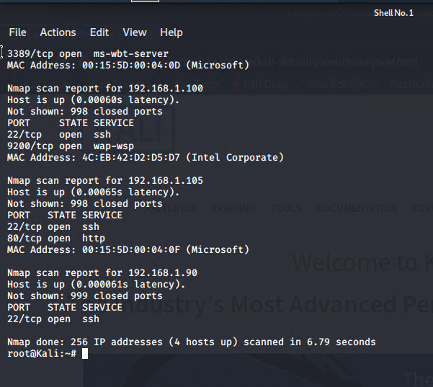
Exploitation: Sensitive Data Exposure
01
Tools & Processes
nmap to scan network
dirb to map URLs
Browser to explore

Slide 11
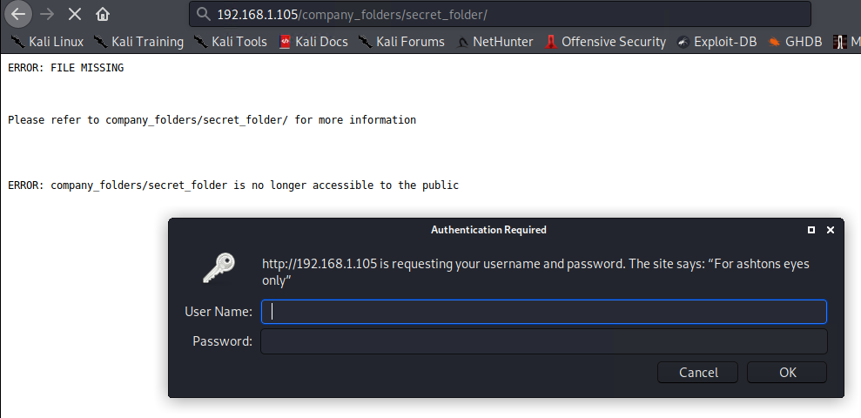
Exploitation: Sensitive Data Exposure
02
Achievements
The exploit revealed a secret_folder directory.
This directory is password protected, but susceptible to brute-force.

Slide 12
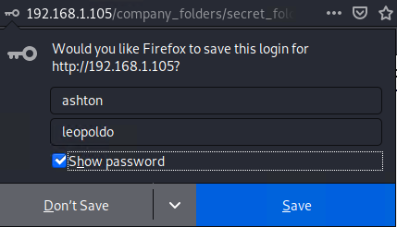
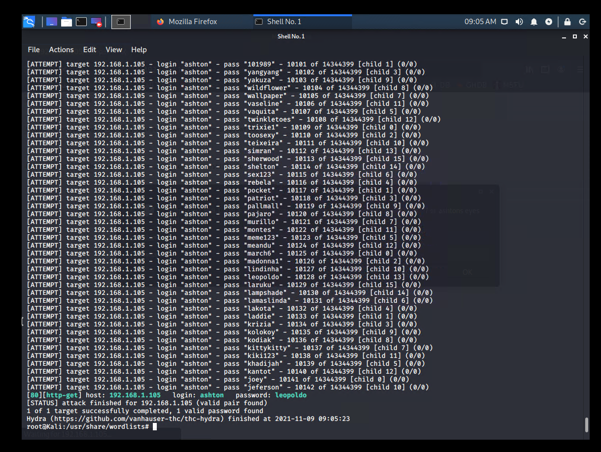
Exploitation: Sensitive Data Exposure
03
Exploitation
The login prompt reveals that the user is ashton.
This information is used to run a brute-force attack and steal the data.

Slide 13
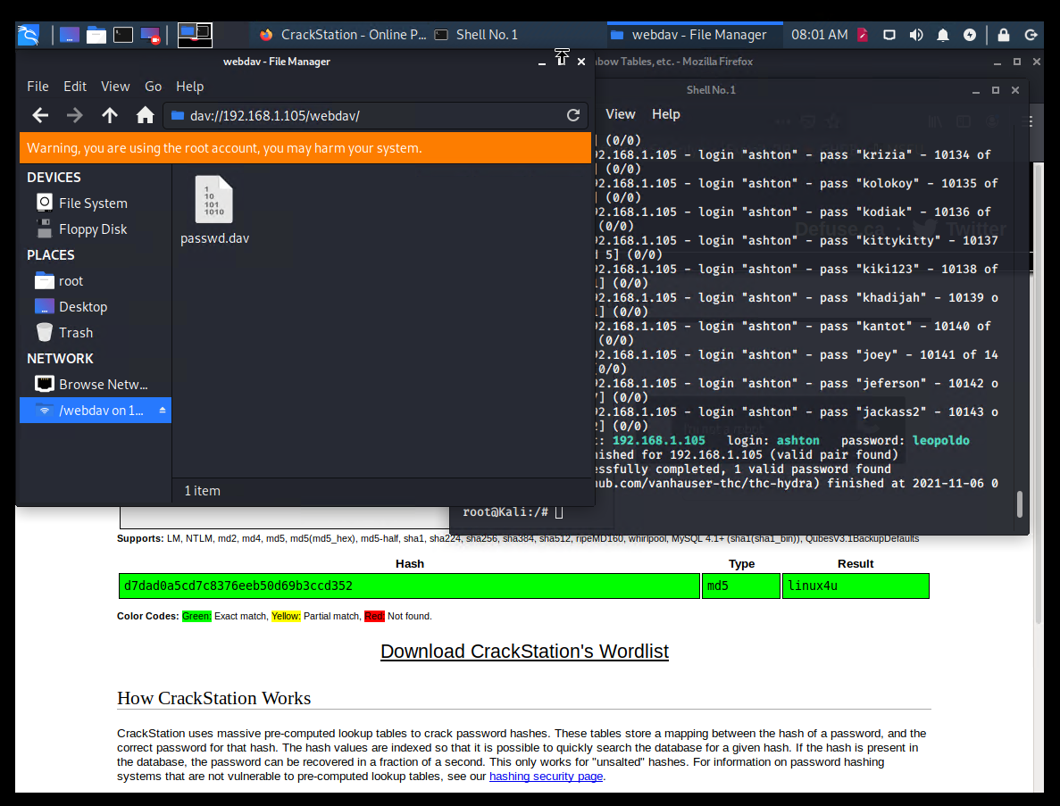
Exploitation: Unauthorized File Upload
01
Tools & Processes
Crack stolen credentials to connect via WebDAV
Generate custom web shell with msfconsole
Upload shell via WebDAV

Slide 14
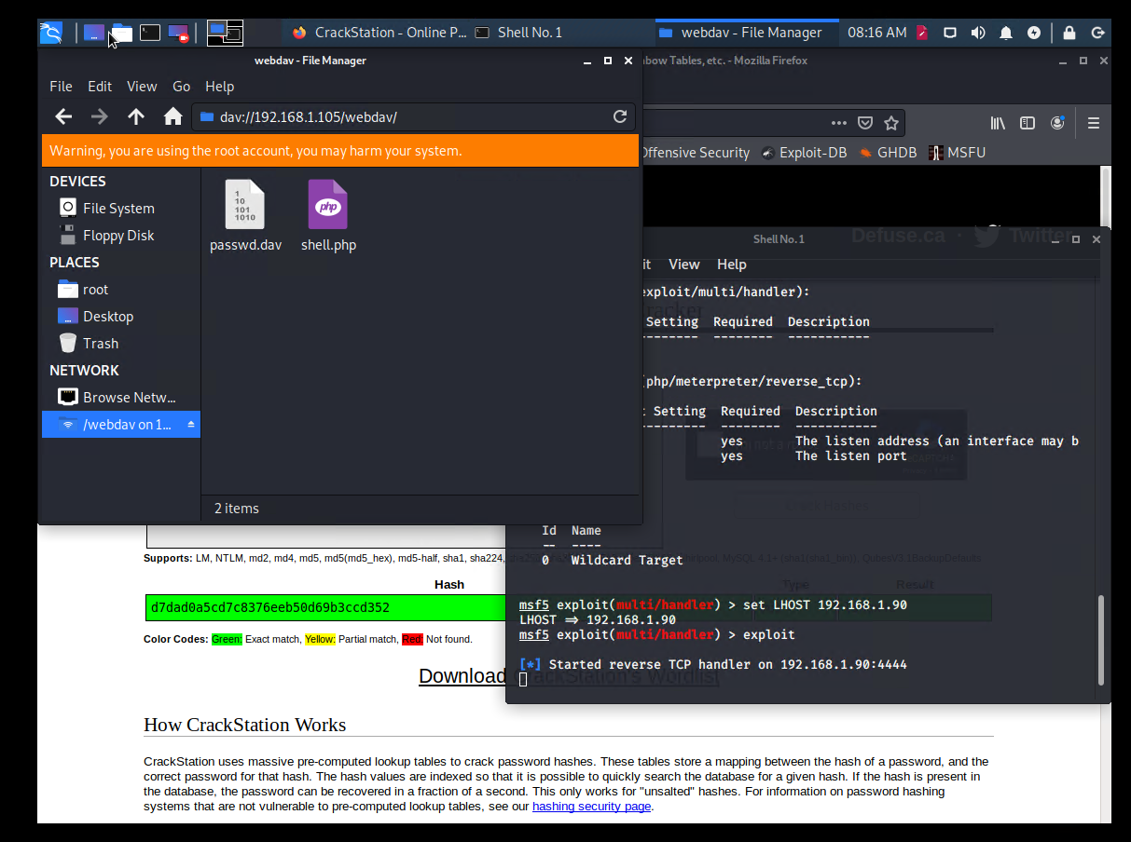
Exploitation: Unauthorized File Upload
02
Achievements
Uploading a web shell allows us to execute arbitrary shell commands on the target

Slide 15
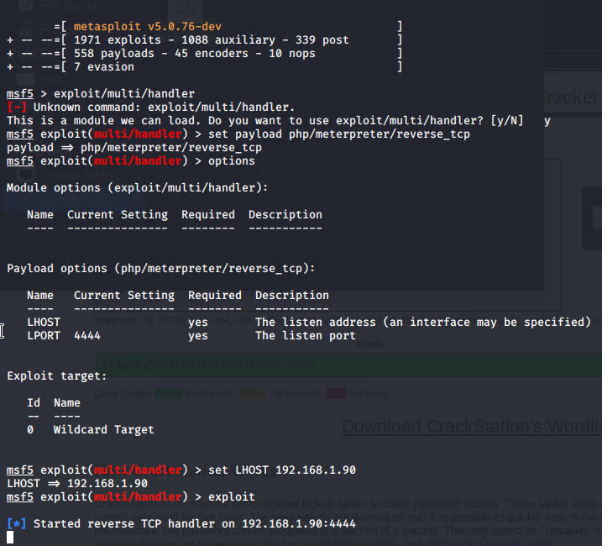
Exploitation: Unauthorized File Upload
03
Aftermath
Running arbitrary shell commands allows Meterpreter to open a full-fledged connection to the target

Slide 16
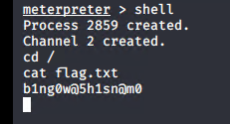
Exploitation: Remote Code Execution
01
02
03
Tools & Processes
Use Meterpreter to connect to uploaded web shell
Use shell to explore and compromise target
Achievements
Leveraging the RCE allows us to open a Meterpreter shell to the target
Once on the target, the full file system is available for exploration
Aftermath
Achieving a shell on the target allows us to display all files and capture the flag

Slide 17

Blue Team
Log Analysis and Attack Characterization
‹#›

Slide 18
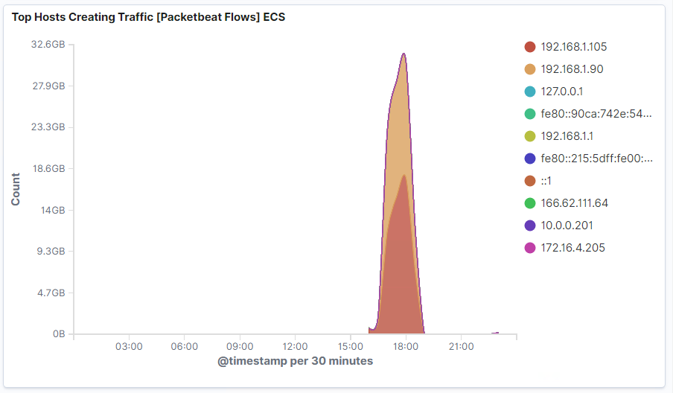
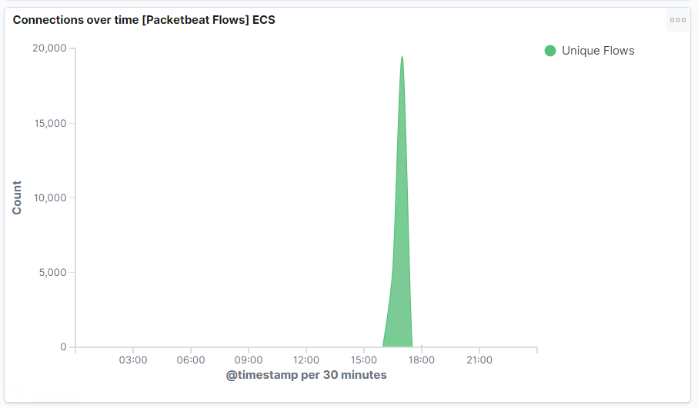
Analysis: Identifying the Port Scan
What time did the port scan occur?
16:00-19:00
How many packets were sent and from which IP?
We can observe about 17,000
The IP address 192.168.1.90

Slide 19
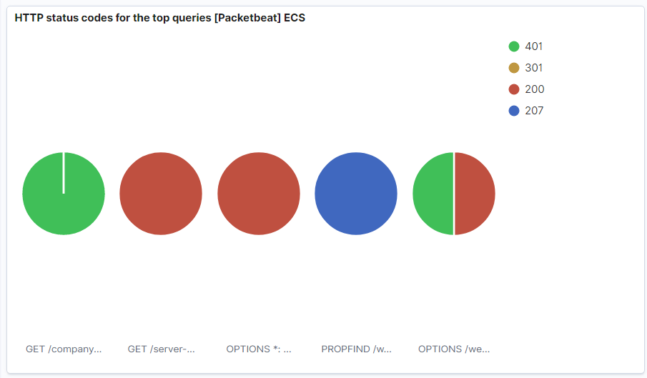
Analysis: Identifying the Port Scan (cont.)
We can observe that the victim responded back with:
401 (Unauthorized)
207 (Multi-Status)
200 (OK)
404 (Not found)

Slide 20
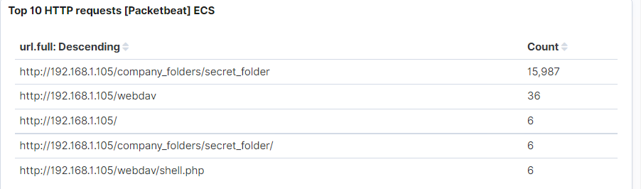
Analysis: Finding the Request for the Hidden Directory
What time did the request occur? How many requests were made?
In the first screenshot we can observe that the attack started at 16:00 with 1 requests to the secret folder.
Which files were requested? What did they contain? The top three hits for directories and files that were requested were:
http://192.168.1.105/company_folder/secret_folder
http://192.168.1.105/company_folder/webdav
http://192.168.1.105/webdav/shell.php

Slide 21
Analysis: Finding the WebDAV Connection
The secret_folder directory was requested 15,987 times.
The shell.php file was requested 6 times.

Slide 22
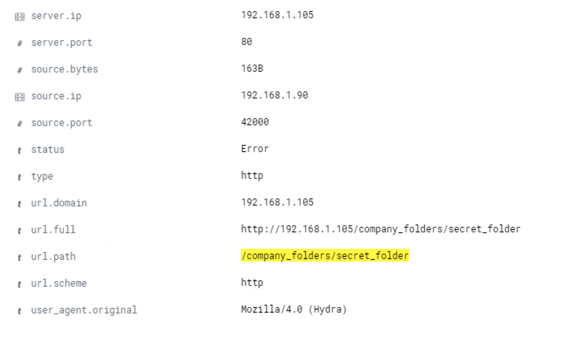
Analysis: Uncovering the Brute Force Attack
The logs contain evidence of a large number of requests for the sensitive data. Only 2 requests were successful. This is a telltale signature of a brute-force attack.
Specifically, the password protected secret_folder was requested 15,987 times.
Out of 15,987 requests, only 2 were successful.
Notes:
Note: The image on the right hand side is an example of hydra failing to access the contents of the secret_folder directory.

Slide 23
Blue Team
Proposed Alarms and Mitigation Strategies
‹#›

Slide 24
Mitigation: Blocking the Port Scan
What kind of alarm can be set to detect future port scans?
# of Requests per Second
What threshold would you set to activate this alarm?
Alarms should fire if a given IP address sends more than 10 requests per second for more than 5 seconds
What configurations can be set on the host to mitigate port scans?
The local firewall can be used to throttle incoming connections
Firewall should be regularly patched to minimise new attacks
ICMP traffic can be filtered
An IP allowed list can be enabled
Regularly run port scans to detect and audit any open ports

Slide 25
Mitigation: Finding the Request for the Hidden Directory
What kind of alarm can be set to detect future unauthorized access?
Allow authorized IP addresses
Trip alarm if an IP not on the allow list attempts to connect
What threshold would you set to activate this alarm?
This is a binary alarm: If the incoming IP is not allowed, it fires. Otherwise, it does not.
What configuration can be set on the host to block unwanted access?
Access to the sensitive file can be locally restricted to a specific user.
This way, someone who gets a shell as, e.g., www-data will not be able to read it.
In addition, the file should be encrypted at rest.
Confidential folders should not be shared for public access.

Slide 26
Mitigation: Preventing Brute Force Attacks
What kind of alarm can be set to detect future brute force attacks?
# of Requests per Second
What threshold would you set to activate this alarm?
More than 100 requests per second for 5 seconds should trigger the alarm
What configuration can be set on the host to block brute force attacks?
Configuring fail2ban or a similar utility would mitigate brute force attacks
Create a policy that locks out accounts after 10 failed attempts
Create a policy that increases password complexity
Enable MFA

Slide 27
Mitigation: Detecting the WebDAV Connection
What kind of alarm can be set to detect future access to this directory?
Monitor access to webdav with Filebeat
Fire an alarm on any read performed on files within webdav
What threshold would you set to activate this alarm?
Simply fire the alarm whenever someone accesses the webdav directory.
Ideally, allow valid IP addresses.
What configuration can be set on the host to control access?
Administrators must install and configure Filebeat on the host.
Create a whitelist of trusted IP addresses
User Access Reviews would be performed every 6 months

Slide 28
Assessment Summary
The Red Team uncovered the following vulnerabilities:
Accessed the system via HTTP Port 80
Found Root accessibility
Found the occurrence of simplistic usernames and weak passwords
Brute forced passwords to gain system access
Cracked a hashed password to gain system access and use a shell script
Identified Directory Indexing Vulnerability CWE-548
The Blue Team:
Confirmed that a port scan occurred
Found requests for a hidden directory
Found evidence of a brute force attack
Found requests to access critical system folders and files
Identified a WebDAV vulnerability
Recommended alarms
Recommended system hardening
Notes:
Note: The image on the right hand side is an example of hydra failing to access the contents of the secret_folder directory.

